Slide 1

Retail Credit Monitoring
2019Q4

Slide 2
Table of Contents
Page | Report Title | Page | Report Title
3 | First Approval Rate & Final Approval Rate |  | Portfolio Concentration by Payment Type – HP
4 | Net Volume Change - HP |  | Portfolio Concentration by Customer Type – HP
 | Net Volume Change - Operating Lease |  | Portfolio Concentration by New/Used Car - HP
5 | New Contract Concentration by Brand - HP |  | Delinquency Development M2(31-60 days) by Down payment - HP
 | New Contract Concentration by Term - HP | 8 | Write-off Development M2(31-60 days) by Down payment – HP
 | New Contract Concentration by Down Payment - HP | 9 | Overruling Ratios - Excluding MBUC
 | New Contract Concentration by Payment Type - HP |  | Write-off Development M2(31-60 days) by Payment – HP
 | New Contract Concentration by Term – OP |  | Delinquency Development M2(31-60 days) by Customer - HP
 | New Contract Concentration by Downpayment - OP |  | Write-off Development M2(31-60 days) by Customer – HP
6 | Portfolio Growth |  | Delinquency Development M2(31-60 days) by Brand – HP
7 | Portfolio Concentration by Brand - HP |  | Write-off Development M2(31-60 days) by Brand – HP
 | Portfolio Concentration by Term – HP |  | Roll Rates - HP
 | Portfolio Concentration by Down Payment – HP |  | Appendix

Slide 3
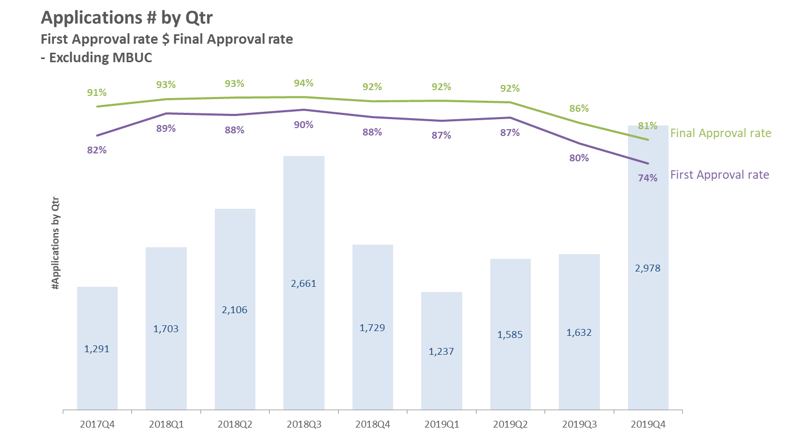
Lower approval rate since 2019Q3
is primarily due to multi-brand used car.
Notes:
1. 2019Q3 Report的2019Q3有案件重複63件
2. 另外有14件於2019Q3進件但2019Q4才成案
3. 2019Q4 Report 的Bar 改為進件數(原為成案數)

Slide 4
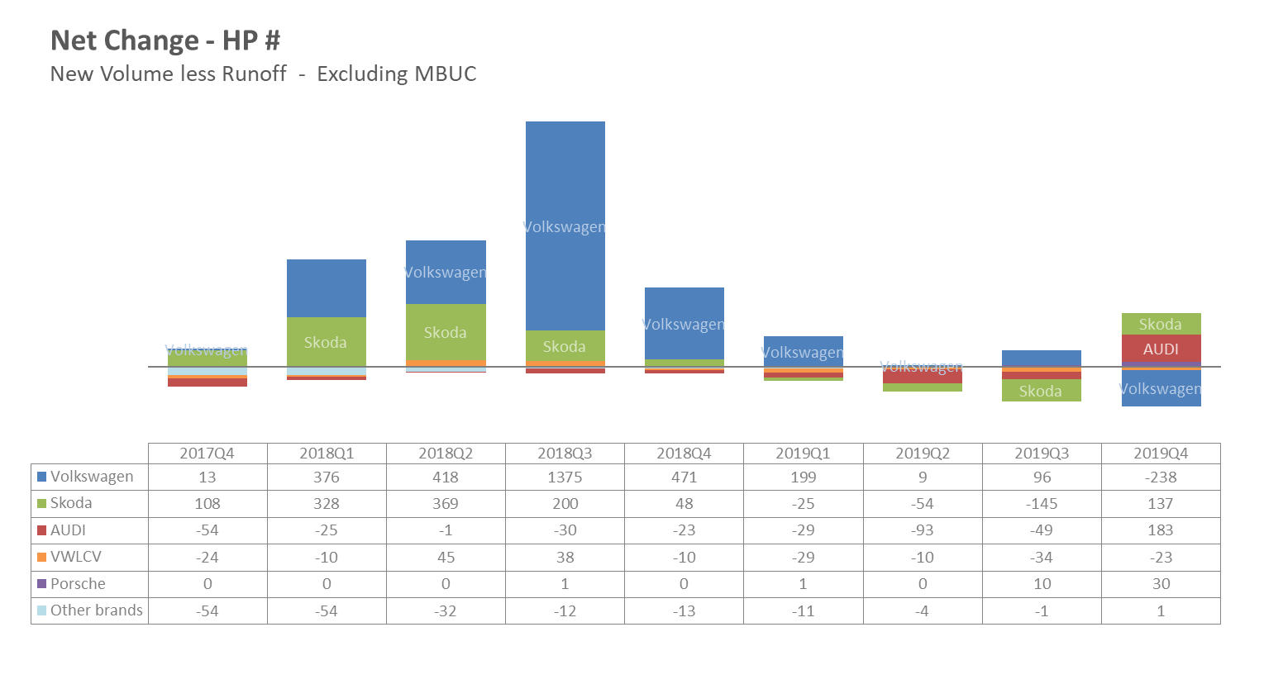
Increasing volume of AUDI in 2019Q4
is mainly due to favorable
campaigns and more sales reward cars.
Notes:
2019Q3 Report中 的2019Q3尚未排除多品牌中古車
*Favorable campaigns : BLI(Bundle Loyalty Insurance) => BI(+27) and BL(+78)
*confirmed sales reward cars : +23, this number is underestimated because there are more sales reward cars we don’

Slide 5
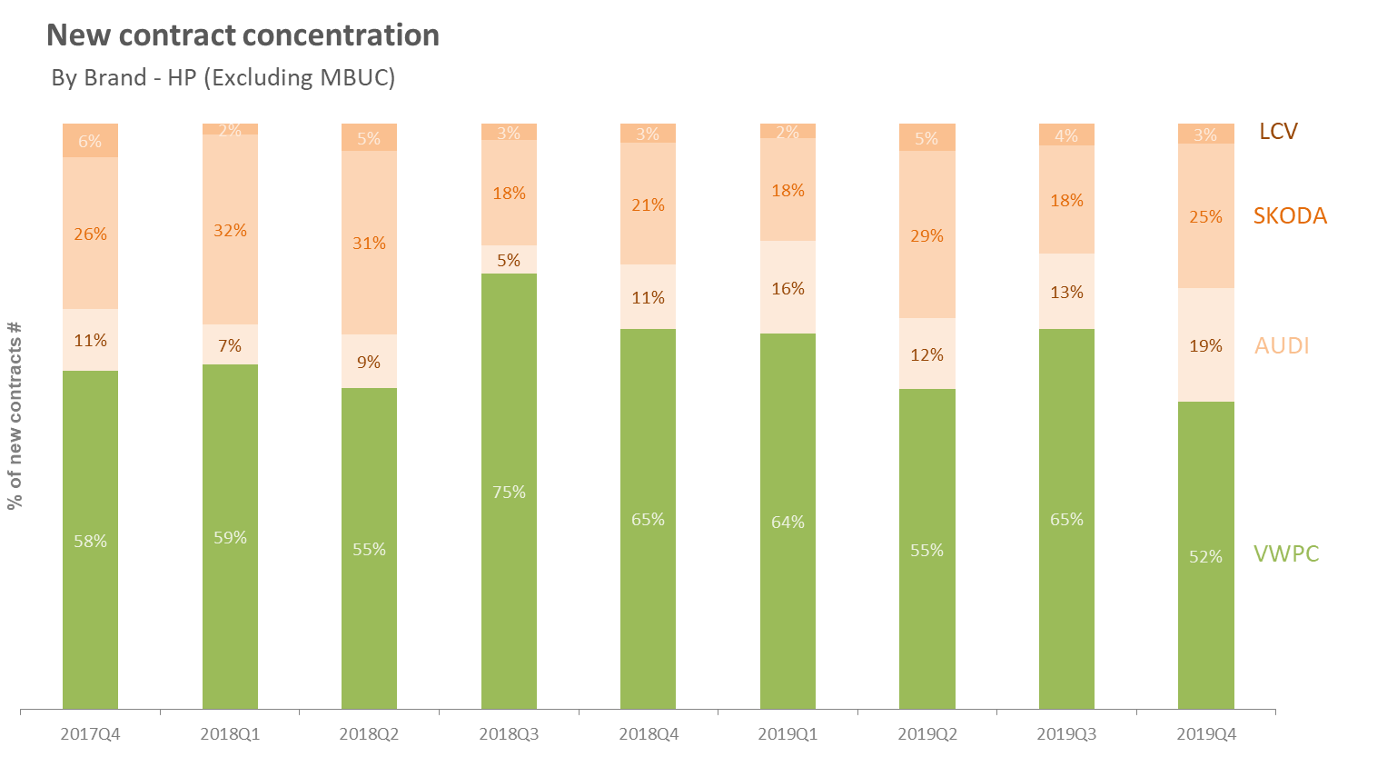

Slide 6
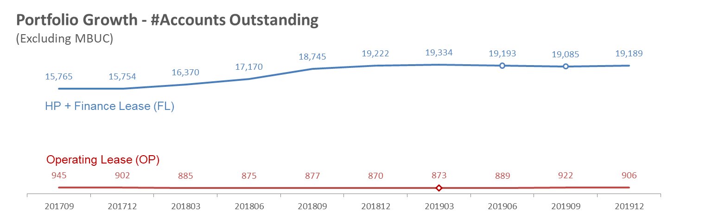
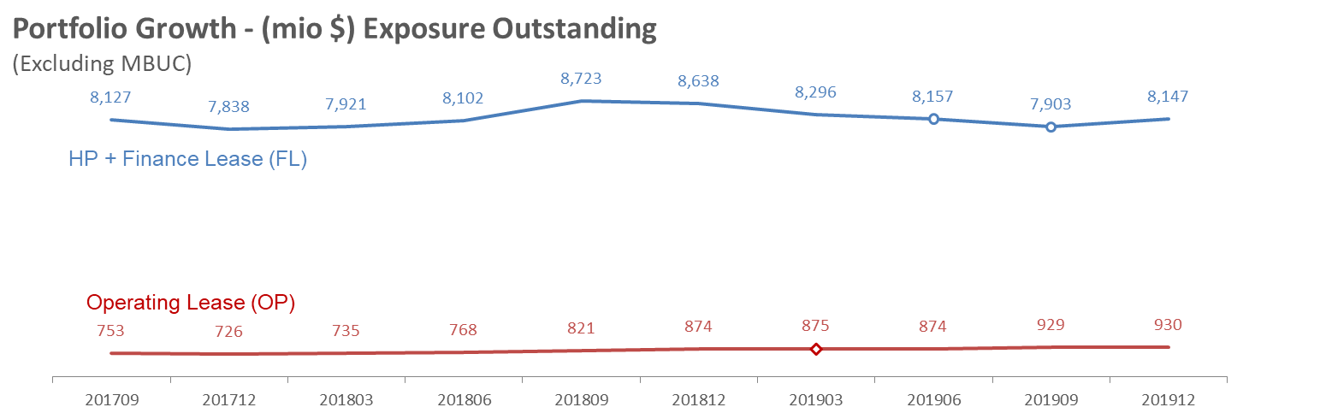
Notes:
2019Q3 Report中 的2019Q3尚未排除多品牌中古車

Slide 7
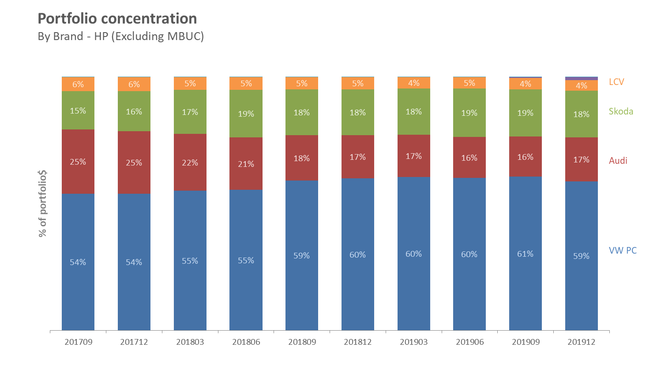

Slide 8
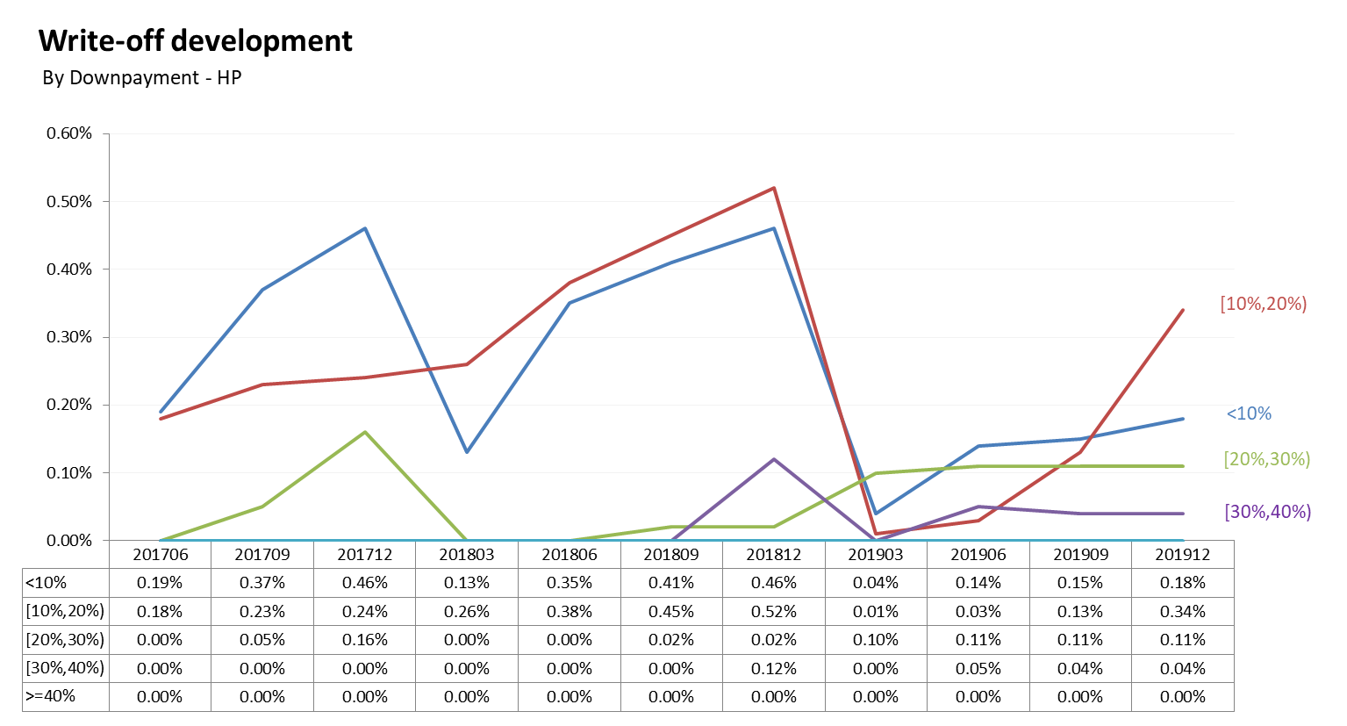
Notes:
更正數據，Q3誤植。

Slide 9
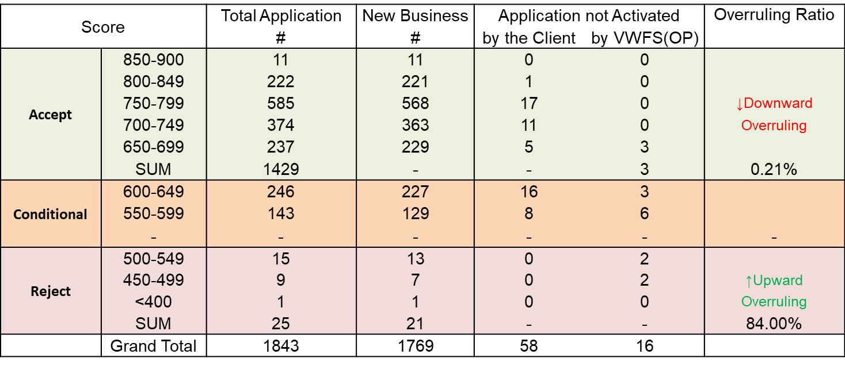
Overruling Ratios - Excluding MBUC Scorecard decision vs. Final decision
*Observation period: 2019/10/01 - 2019/12/31
*Only for Retail Individual Customers
Notes:
此為Scorecard 與 OP最終審核結果之Overruling 數據

